Slide 1
18CSC202J - Syllabus
Unit 3 :
Single and Multiple Inheritance - Multilevel inheritance - Hierarchical - Hybrid Inheritance - Advanced Functions - Inline - Friend - Virtual -Overriding - Pure virtual function -Abstract class and Interface -UML State Chart Diagram - UML Activity Diagram

Slide 2


Inheritance
Inheritance is the capability of one class to acquire properties and characteristics from another class. The class whose properties are inherited by other class is called the Parent or Base or Super class. And, the class which inherits properties of other class is called Child or Derived or Sub class.
01
Definition
02
Syntax
Single Inheritance, Multiple Inheritance, Hierarchical Inheritance, Multilevel Inheritance, and Hybrid Inheritance (also known as Virtual Inheritance)
Note : All members of a class except Private, are inherited
03
Types
Code Reusability
Method Overriding (Hence, Runtime Polymorphism.)
Use of Virtual Keyword
04
Advantages

Slide 3
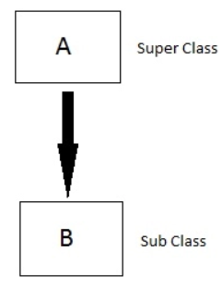
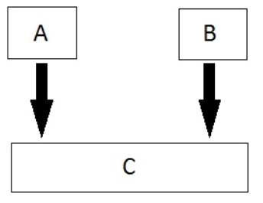
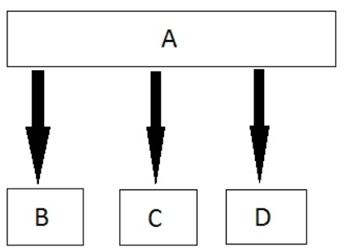
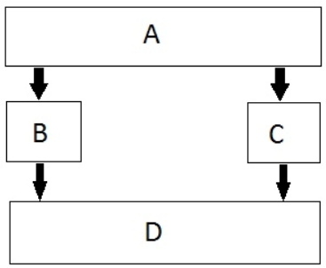
Inheritance Types
01
Single
02
Multiple
03
Hierarchical
04
Multilevel
05
Hybrid

Slide 4
Modes of Inheritance
If we derive a sub class from a public base class. Then the public member of the base class will become public in the derived class and protected members of the base class will become protected in derived class
01
Public
If we derive a sub class from a Protected base class. Then both public member and protected members of the base class will become protected in derived class.
02
Protected
If we derive a sub class from a Private base class. Then both public member and protected members of the base class will become Private in derived class.
03
private
The private members in the base class cannot be directly accessed in the derived class, while protected members can be directly accessed. For example, Classes B, C and D all contain the variables x, y and z in below example
Note:

Slide 5
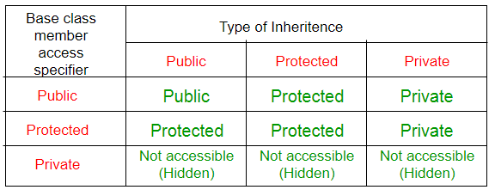
Inheritance Access Matrix

Slide 6
SINGLE INHERITANCE
Example
Base Class
ClassA
Base Class
Derived Class
Class B
Derived Class

Slide 7
Single Inheritance
In single inheritance, a class is allowed to inherit from only one class. i.e. one sub class is inherited by one base class only. Based on the visibility mode used or access specifier used while deriving, the properties of the base class are derived. Access specifier can be private, protected or public.
Syntax:
class Classname // base class
{
..........
};
class classname: access_specifier baseclassname
{
…
};

Slide 8
Example
#include <iostream>
using namespace std;
class base //single base class
{ public:
int x;
void getdata()
{
cout << "Enter the value of x = ";
cin >> x;
}
};
class derived : public base //single derived class
{
int y;
public:
void readdata()
{
cout << "Enter the value of y = ";
cin >> y;
}
void product()
{
cout << "Product = " << x * y;
}
};
int main()
{
derived a; //object of derived class
a.getdata();
a.readdata();
a.product();
return 0;
}

Slide 9
Applications of Single Inheritance
Grading System
University Grading System
Employee and Salary
Student

Slide 10
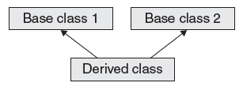
Multiple Inheritance
Base Class
Base Class

Slide 11
Multiple Inheritance
In this type of inheritance a single derived class may inherit from two or more than two base classes.
Syntax:
class A // base class
{
..........
};
class B
{
..........
}
class c : access_specifier A, access_specifier B // derived class
{
...........
} ;

Slide 12
Example:
#include using namespace std;
class sum1
{
protected: int n1;
};
class sum2
{
protected: int n2;
};
class show : public sum1, public sum2
{
public: int total()
{
cout<<“enter n1”;
cin>>n1;
cout<<“enter n2″;
cin>>n2;
cout<<“sum=”<
cout<<“sum=”<<n1+n2<<endl;
}
};
int main()
{
sum2 ob;
ob.total();
}

Slide 13
Applications of Multiple Inhertiance
Distributed Database

Slide 14
Multilevel Inheritance
A derived class can be derived from another derived class. A child class can be the parent of another class.
Syntax:
class A // base class
{
..........
};
class B
{
..........
}
class C : access_specifier B
// derived class
{
...........
} ;

Slide 15
// base class
class Vehicle
{
public:
Vehicle()
{
cout << "This is a Vehicle";
}
};
class fourWheeler: public Vehicle
{ public:
fourWheeler()
{
cout<<"Objects with 4 wheels are vehicles"<<endl;
}
};
// sub class derived from two base classes
class Car: public fourWheeler{
public:
car()
{
cout<<"Car has 4 Wheels”;
}
};
// main function
int main()
{
//creating object of sub class will
//invoke the constructor of base classes
Car obj;
return 0;
}

Slide 16
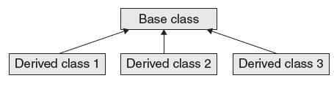
Hierarchical Inheritance

Slide 17
Hierarchical Inheritance
In this type of inheritance, more than one sub class is inherited from a single base class. i.e. more than one derived class is created from a single base class.
Syntax:
class A // base class
{
};
class B : access_specifier A
{
} ;
class C : access_specifier A
{
} ;
class D : access_specifier A
{
} ;

Slide 18
Example
#include <iostream>
using namespace std;
class A //single base class
{
public:
int x, y;
void getdata()
{
cout << "\nEnter value of x and y:\n";
cin >> x >> y;
}
};
class B : public A //B is derived from class base
{
public:
void product()
{
cout << "\nProduct= " << x * y;
}
};
class C : public A //C is also derived from class base
{
public:
void sum()
{
cout << "\nSum= " << x + y;
}
};
int main()
{
B obj1; //object of derived class B
C obj2; //object of derived class C
obj1.getdata();
obj1.product();
obj2.getdata();
obj2.sum();
return 0;
}

Slide 19
Order of Constructor Call
Base class constructors are always called in the derived class constructors. Whenever you create derived class object, first the base class default constructor is executed and then the derived class's constructor finishes execution.
Points to Remember
Whether derived class's default constructor is called or parameterised is called, base class's default constructor is always called inside them.
To call base class's parameterised constructor inside derived class's parameterised constructor, we must mention it explicitly while declaring derived class's parameterized constructor.

Slide 20
Example
class Base
{
int x;
public:
Base()
{
cout<<"Base default constructor";
}
};
class Derived : public Base
{
int y;
public:
Derived()
{
cout<"Derived def. constructor";
}
// parameterized constructor
Derived(int i)
{
cout << "Derived parameterized constructor\n";
}
};
int main()
{
Base b;
Derived d1;
Derived d2(10);
}

Slide 21
Order of Constructor Call
class Base
{
int x;
public:
// parameterized constructor
Base(int i)
{
x = i;
cout<<"BaseParameterized Constructor\n";
}
};
class Derived : public Base
{
int y;
public:
// parameterized constructor
Derived(int j):Base(j)
{
y = j;
cout << "Derived Parameterized Constructor\n";
}
};
int main()
{
Derived d(10) ;
}
Example:

Slide 22
Note:
Constructors have a special job of initializing the object properly. A Derived class constructor has access only to its own class members, but a Derived class object also have inherited property of Base class, and only base class constructor can properly initialize base class members. Hence all the constructors are called, else object wouldn't be constructed properly.

Slide 23
Constructors and Destructors are never inherited and hence never overridden.
Also, assignment operator = is never inherited. It can be overloaded but can't be inherited by sub class.
Concept
01
They are inherited into the derived class.
If you redefine a static member function in derived class, all the other overloaded functions in base class are hidden.
Static Member functions can never be virtual.
02
Static Function
Derived class can inherit all base class methods except:
Constructors, destructors and copy constructors of the base class.
Overloaded operators of the base class.
The friend functions of the base class.
03
Limitation

Slide 24
Calling base and derived class method using base reference
Example:
#include <iostream>
using namespace std;
class Foo
{
public:
int x;
virtual void printStuff()
{
cout<<"BaseFoo printStuff called"<<endl;
}
};
class Bar : public Foo
{
public:
int y;
void printStuff()
{
cout<<"derived Bar printStuff called"<<endl;
}
};
int main()
{
Foo *foo=new Foo;
foo->printStuff();/////this call the base function
foo=new Bar;
foo->printStuff();
}
Output:
Base Foo printStuff called
derived Bar printStuff called

Slide 25
Calling base and derived class method using derived reference
Example:
#include <iostream>
class Base{
public:
void foo()
{
std::cout<<"base";
}
};
class Derived : public Base
{
public:
void foo()
{
std::cout<<"derived";
}
};
int main()
{
Derived bar;
//call Base::foo() from bar here?
bar.Base::foo(); // using a qualified-id
return 0;
}
Output:
base

Slide 26
Hierarichal Inheritance

Slide 27
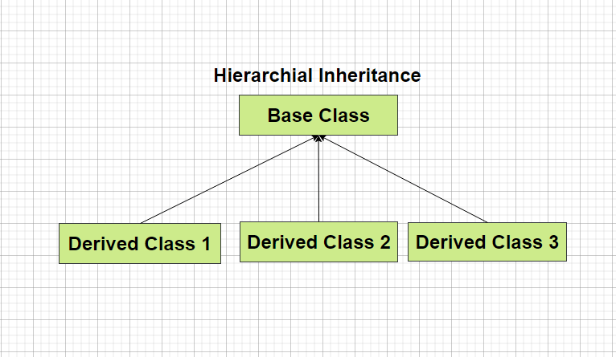
Hierarichal Inheritance
In Hierarichal Inheritance we have several classes that are derived from a common base class (or parent class).
Here in the diagram Class 1, Class 2 and Class 3 are derived from a common parent class called Base Class.

Slide 28
Diagramatic Representation of Hierarichal Inheritance

Slide 29
How to implement Hierarichal Inheritance in C++
class A {
// Body of Class A
}; // Base Class
class B : access_specifier A
{
// Body of Class B
}; // Derived Class
class C : access_specifier A
{
// Body of Class C
}; // Derived Class
In the example present in the left we have class A as a parent class and class B and class C that inherits some property of Class A.
While performing inheritance it is necessary to specify the access_specifier which can be public, private or protected.

Slide 30
Access Specifiers
In C++ we have basically three types of access specifiers :
Public : Here members of the class are accessible outside the class as well.
Private : Here members of the class are not accessible outside the class.
Protected : Here the members cannot be accessed outside the class, but can be accessed in inherited classes.

Slide 31
Example of Inheritance
class Car {
public:
int wheels = 4;
void show() {
cout << "No of wheels : "<<wheels ;
}
};
class Audi: public Vehicle {
public:
string brand = "Audi";
string model = “A6”;
};
class Volkswagen: public Car {
public:
string brand = "Volkswagen";
string model = “Beetle”;
};
class Honda: public Car {
public:
string brand = "Honda";
string model = “City”;
};

Slide 32
Hybrid Inheritance

Slide 33
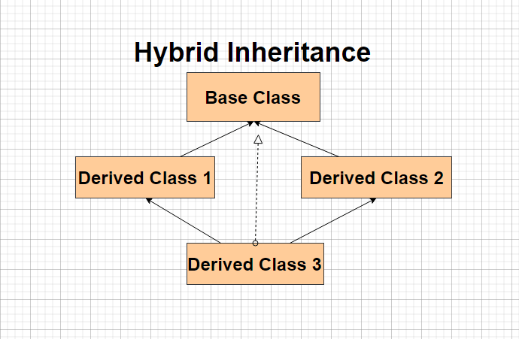
Hybrid Inheritance
Hybrid Inheritance involves derivation of more than one type of inheritance.
Like in the given image we have a combination of hierarichal and multiple inheritance.
Likewise we can have various combinations.

Slide 34
Diagramatic Representation of Hybrid Inheritance

Slide 35
How to implement Hybrid Inheritance in C++
class A
{
// Class A body
};
class B : public A
{
// Class B body
} ;
class C
{
// Class C body
};
class D : public B, public C
{ // Class D body
};
Hybrid Inheritance is no different than other type of inheritance.
You have to specify the access specifier and the parent class in front of the derived class to implement hybrid inheritance.

Slide 36
Access Specifiers
In C++ we have basically three types of access specifiers :
Public : Here members of the class are accessible outside the class as well.
Private : Here members of the class are not accessible outside the class.
Protected : Here the members cannot be accessed outside the class, but can be accessed in inherited classes.

Slide 37
Example of Hybrid Inheritance
class A
{
public:
int x;
};
class B : public A
{
public:
B()
{
x = 10;
}
};
class C
{ public:
int y;
C()
{
y = 4;
}
};
class D : public B, public C
{ public:
void sum()
{
cout << "Sum= " << x + y;
}
};

Slide 38
Virtual function and abstract class

Slide 39
C++ Virtual Functions
A virtual function is a member function of the base class, that is overridden in derived class. The classes that have virtual functions are called polymorphic classes.
The compiler binds virtual function at runtime, hence called runtime polymorphism. Use of virtual function allows the program to decide at runtime which function is to be called based on the type of the object pointed by the pointer.
In C++, the member function of a class is selected at runtime using virtual function. The function in the base class is overridden by the function with the same name of the derived class.

Slide 40
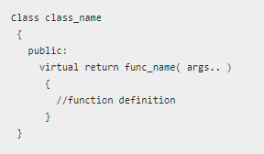
C++ virtual function : Syntax

Slide 41
Why do we need virtual functions?
Virtual functions are needed for many reasons, among them to eliminate ambiguity is one.

Slide 42
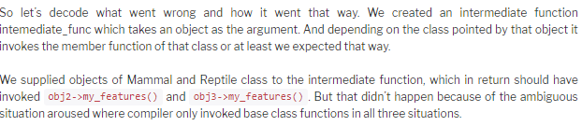


Slide 43
C++ abstract class and pure virtual function : Introduction
A class that is declared using “abstract” keyword is known as abstract class. It can have abstract methods(methods without body) as well as concrete methods (regular methods with body). A normal class(non-abstract class) cannot have abstract methods.
An abstract class can not be instantiated, which means you are not allowed to create an object of it.

Slide 44
By definition, an abstract class in C++ is a class that has at least one pure virtual function (i.e., a function that has no definition). The classes inheriting the abstract class must provide a definition for the pure virtual function; otherwise, the subclass would become an abstract class itself.
Abstract classes are essential to providing an abstraction to the code to make it reusable and extendable.

Slide 45
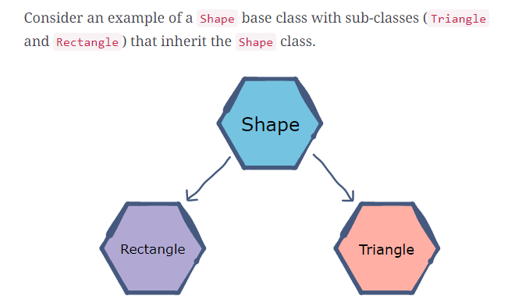

Slide 46
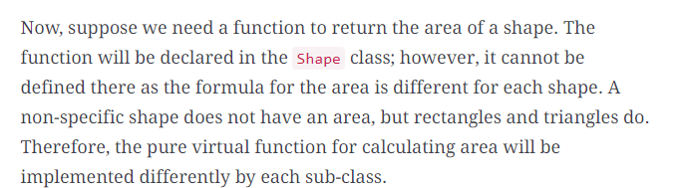

Slide 47
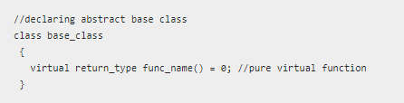
C++ abstract class : syntax and structure

Slide 48
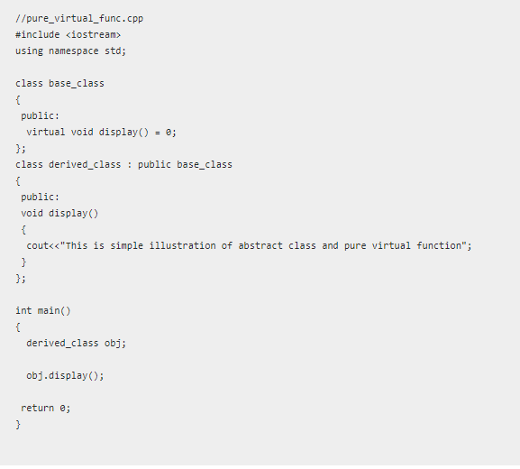
example

Slide 49

Example
A class having a pure virtual function cannot be instantiated i.e the object of abstract classes cannot be created. However, a pointer to the abstract base class or abstract class can be created. They only serve as the foundation to derive subclasses.
Another important thing about pure virtual function and abstract class is that the pure virtual function must be overridden in derived class. Else the pure inherited pure virtual function remains same in all derived classes. Hence pure abstract classes and pure virtual function allow a programmer to build the implementation in stages.

Slide 50
Friend Function
1. The main concepts of the object oriented programming paradigm are data hiding and data encapsulation.
2. Whenever data variables are declared in a private category of a class, these members are restricted from accessing by non – member functions.
3. The private data values can be neither read nor written by non – member functions.
4. If any attempt is made directly to access these members, the compiler will display an error message as “inaccessible data type”.
5. The best way to access a private data member by a non – member function is to change a private data member to a public group.
6. When the private or protected data member is changed to a public category, it violates the whole concept or data hiding and data encapsulation.
7. To solve this problem, a friend function can be declared to have access to these data members.
8. Friend is a special mechanism for letting non – member functions access private data.
9. The keyword friend inform the compiler that it is not a member function of the class.

Slide 51
Friend Function
Granting Friendship to another Class
1. A class can have friendship with another class.
2. For Example, let there be two classes, first and second. If the class first grants its friendship with the other class second, then the private data members of the class first are permitted to be accessed by the public members of the class second. But on the other hand, the public member functions of the class first cannot access the private members of the class second.
Syntax
01
class second; forward declaration
class first
{
private:
--------------

Slide 52
Friend Function
Two classes having the same Friend
1. A non – member function may have friendship with one or more classes.
2. When a function has declared to have friendship with more than one class, the friend classes should have forward declaration.
3. It implies that it needs to access the private members of both classes.
Syntax
01
friend return_type function_name(parameters);
Example
02
friend return_type fname(first one, second two)
{}
Note:
where friend is a keyword used as a function modifier. A friend declaration is valid only within or outside the class definition.
03

Slide 53
Friend Function
Syntax:
class second; forward declaration
class first
{
private:
--------------
public:
friend return_type fname(first one, second two);
};
class second
{
private:
------------------
public:
friend return_type fname(first one, second two);
};
Case 2:
class sample
{
private:
int x;
float y;
public:
virtual void display();
virtual static int sum(); //error
}
int sample::sum()
{ }

Slide 54
Friend Function Example
Example:
class sample
{
private:
int x;
public:
void getdata();
friend void display(sample abc);
};
void sample::getdata()
{
cout<<"Enter a value for x\n"<<endl;
cin>>x;
}
void display(sample abc)
{
cout<<"Entered Number is "<<abc.x<<endl;
}
void main()
{
clrscr();
sample obj;
obj.getdata();
cout<<"Accessing the private data by non - member function"<<endl;
display(obj);
getch();
}*/

Slide 55
Friend Function Example
Example:
class first
{
friend class second;
private:
int x;
public:
void getdata();
};
class second
{
public:
void disp(first temp);
};
void first::getdata()
{
cout<<"Enter a Number ?"<<endl;
cin>>x;
}
void second::disp(first temp)
{
cout<<"Entered Number is = "<<temp.x<<endl;
}
void main()
{
first objx;
second objy;
objx.getdata();
objy.disp(objx);
}

Slide 56
Friend Function Example
class second; //Forward Declaration
class first
{
private:
int x;
public:
void getdata();
void display();
friend int sum(first one,second two);
};
class second
{
private:
int y;
public:
void getdata();
void display();
friend int sum(first one,second two);
};
void first::getdata()
{
cout<<"Enter a Value for X"<<endl;
cin>>x;
}
void second::getdata()
{
cout<<"Enter a value for Y"<<endl;
cin>>y;
}
void first::display()
{
cout<<"Entered Number is X = ";
}
void second::display()
{
cout<<"Entered Number is Y = ";
}
int sum (first one,second two)
{
int temp;
temp = one.x + two.y;
return(temp);
}
void main()
{
first a;
second b;
a.getdata();
b.getdata();
a.display();
b.display();
int te = sum(a,b);
cout<<"Sum of the two Private data variable (X + Y)";
cout<<" = "<<te<<endl;
}

Slide 57
Inline Member Function
Inline functions are used in C++ to reduce the overhead of a normal function call.
A member function that is both declared and defined in the class member list is called an inline member function.
The inline specifier is a hint to the compiler that inline substitution of the function body is to be preferred to the usual function call implementation.
The advantages of using inline member functions are:
1. The size of the object code is considerably reduced.
2. It increases the execution speed, and
3. The inline member function are compact function calls.

Slide 58
Inline Member Function
Syntax:
class user_defined_name
{
private:
-------------
public:
inline return_type function_name(parameters);
inline retrun_type function_name(parameters);
---------------
---------------
};
Syntax
Inline return_type function_name(parameters)
{
----------------
----------------
}

Slide 59
Virtual function
Virtual Function is a function in base class, which is overridden in the derived class, and which tells the compiler to perform Late Binding on this function.
Virtual Keyword is used to make a member function of the base class Virtual. Virtual functions allow the most specific version of a member function in an inheritance hierarchy to be selected for execution. Virtual functions make polymorphism possible.
Key:
Only the Base class Method's declaration needs the Virtual Keyword, not the definition.
If a function is declared as virtual in the base class, it will be virtual in all its derived classes.
Syntax
01
virtual return_type function_name (arg);
Example
02
virtual void show()
{
cout << "Base class\n";
}
Note:
We can call private function of derived class from the base class pointer with the help of virtual keyword. Compiler checks for access specifier only at compile time. So at run time when late binding occurs it does not check whether we are calling the private function or public function.
03

Slide 60
Virtual function features
Case 1:
class sample
{
private:
int x;
float y;
public:
virtual void display();
virtual int sum();
}
virtual void sample::display() //Error
{ }
Case 2:
class sample
{
private:
int x;
float y;
public:
virtual void display();
virtual static int sum(); //error
}
int sample::sum()
{ }

Slide 61
Virtual function features
Case 3:
class sample
{
private:
int x;
float y;
public:
virtual sample(int x,float y); //constructor
void display();
int sum();
}
Case 4:
class sample
{
private:
int x;
float y;
public:
virtual ~sample(int x,float y); //invalid
void display();
int sum();
}

Slide 62
Virtual function features
Case 5:
class sample_1
{
private:
int x;
float y;
public:
virtual int sum(int x,float y); //error
};
class sample_2:public sample_1
{
private:
int z;
public:
virtual float sum(int xx,float yy);
};
Case 6:
virtual void display() //Error, non member function
{
----------------
----------------
}

Slide 63
Virtual Function Example
Example:
class Point
{
protected:
float length,breath,side,radius,area,height;
};
class Shape: public Point
{
public:
virtual void getdata()=0;
virtual void display()=0;
};
class Rectangle:public Shape
{
public:
void getdata()
{
cout<<"Enter the Breadth Value:"<<endl;
cin>>breath;
cout<<"Enter the Length Value:"<<endl;
cin>>length;
}
void display()
{
area = length * breath;
cout<<"The Area of the Rectangle is:"<<area<<endl;
}
};
class Square:public Shape
{
public:
void getdata()
{
cout<<"Enter the Value of the Side of the Box:"<<endl;
cin>>side;
}
void display()
{
area = pow(side,4);
cout<<"The Area of the Square is:"<<area<<endl;
}
};
void main()
{
Shape *s;
Rectangle r;
Triangle t;
s = &r;
s->getdata();
s->display();
s = &t;
s->getdata();
s->display();
}

Slide 64
Difference in invocation for virtual and non virtual function
Example:
class Base
{ public:
void show()
{
cout << "Base class";
}
};
class Derived:public Base
{ public:
void show()
{
cout << "Derived Class";
}
}
int main()
{
Base* b; //Base class pointer
Derived d; //Derived class object
b = &d;
b->show(); //Early Binding Occurs
}
class Base
{ public:
virtual void show()
{
cout << "Base class\n";
} };
class Derived:public Base
{ public:
void show()
{
cout << "Derived Class";
} };
int main()
{
Base* b; //Base class pointer
Derived d; //Derived class object
b = &d;
b->show(); //Late Binding Occurs
}

Slide 65
Difference in invocation for virtual and non virtual function
Example:
#include<iostream>
using namespace std;
class Base {
public:
void foo()
{
std::cout << "Base::foo\n";
}
virtual void bar()
{
std::cout << "Base::bar\n";
}
};
class Derived : public Base {
public:
void foo()
{
std::cout << "Derived::foo\n";
}
virtual void bar()
{
std::cout << "Derived::bar\n";
}
};
int main() {
Derived d;
Base* b = &d;
b->foo(); // calls Base::foo
b->bar(); // calls Derived::bar
}
Output:
Base::foo
Derived::bar

Slide 66
Override
Example:
#include <iostream>
using namespace std;
class Base {
public:
// user wants to override this in the derived class
virtual void func()
{
cout << "I am in base" << endl;
}
};
class derived : public Base {
public:
// did a mistake by putting an argument "int a"
void func(int a) override
{
cout << "I am in derived class" << endl;
}
};
int main()
{
Base b;
derived d;
cout << "Compiled successfully" << endl;
return 0;
}
Output:
Base::foo
Derived::bar

Slide 67
Pure Virtual function
Pure virtual Functions are virtual functions with no definition. They start with virtual keyword and ends with = 0. Here is the syntax for a pure virtual function.
Pure Virtual functions can be given a small definition in the Abstract class, which you want all the derived classes to have. Still you cannot create object of Abstract class.
Also, the Pure Virtual function must be defined outside the class definition. If you will define it inside the class definition, complier will give an error. Inline pure virtual definition is Illegal.
Abstract Class is a class which contains atleast one Pure Virtual function in it. Abstract classes are used to provide an Interface for its sub classes. Classes inheriting an Abstract Class must provide definition to the pure virtual function, otherwise they will also become abstract class.
Syntax
01
virtual void f() = 0;
Example
class Base
{
public:
virtual void show() = 0; // Pure Virtual Function
};
02
Note:
We can call private function of derived class from the base class pointer with the help of virtual keyword. Compiler checks for access specifier only at compile time. So at run time when late binding occurs it does not check whether we are calling the private function or public function.
03

Slide 68
Pure Virtual function
Example:
class pet
{
private:
char name[5];
public:
virtual void getdata()=0;
virtual void display()=0;
};
class fish:public pet
{
private:
char environment[10];
char food[10];
public:
void getdata();
void display();
};
class dog: public pet
{
private:
char environment[10];
char food[10];
public:
void getdata();
void display();
};
void fish::getdata()
{
cout<<"Enter the Fish Environment required"<<endl;
cin>>environment;
cout<<"Enter the Fish food require"<<endl;
cin>>food;
}
void fish::display()
{
cout<<"Fish Environment="<<environment<<endl;
cout<<"Fish Food="<<food<<endl;
cout<<"-------------------------------------"<<endl;
}

Slide 69
Pure Virtual function
Example:
void dog::getdata()
{
cout<<"Enter the Dog Environment required"<<endl;
cin>>environment;
cout<<"Enter the Dog Food require"<<endl;
cin>>food;
}
void dog::display()
{
cout<<"Dog Environment="<<environment<<endl;
cout<<"Dog Food="<<food<<endl;
cout<<"---------------------------------------"<<endl;
}
void main()
{
pet *ptr;
fish f;
ptr=&f;
ptr->getdata();
ptr->display();
dog d;
ptr=&d;
ptr->getdata();
ptr->display();
getch();
}

Slide 70
Abstract Class
Abstract class cannot be instantiated, but pointers and references of Abstract class type can be created.
Abstract class can have normal functions and variables along with a pure virtual function.
Abstract classes are mainly used for Upcasting, so that its derived classes can use its interface.
Classes inheriting an Abstract Class must implement all pure virtual functions, or else they will become Abstract too.

Slide 71
Pure virtual function
Example:
/Abstract base class
class Base
{
public:
virtual void show() = 0; // Pure Virtual Function
};
class Derived:public Base
{
public:
void show()
{
cout << "Implementation of Virtual Function in Derived class\n";
}
};
int main()
{
Base obj; //Compile Time Error
Base *b;
Derived d;
b = &d;
b->show();
}

Slide 72
State chart diagram
18CS202J OBJECT ORIENTED DESIGN AND PROGRAMMING

Slide 73
State diagram
A state diagram is used to represent the condition of the system or part of the system at finite instances of time. It’s a behavioural diagram and it represents the behaviour using finite state transitions. State diagrams are also referred to as State machines and State-chart Diagrams.

Slide 74
Uses of state chart diagram
State chart diagrams are useful to model reactive systems
-Reactive systems can be defined as a system that responds to external or internal events.
• State chart diagram describes the flow of control from one state to another state.

Slide 75
Purpose
Following are the main purposes of using State chart diagrams:
To model dynamic aspect of a system.
To model life time of a reactive system.
To describe different states of an object during its life time.
Define a state machine to model states of an object.

Slide 76
Difference between state diagram and flowchart
The basic purpose of a state diagram is to portray various changes in state of the class and not the processes or commands causing the changes.
However, a flowchart on the other hand portrays the processes or commands that on execution change the state of class or an object of the class.

Slide 77
When to use State charts
So the main usages can be described as:
To model object states of a system.
To model reactive system. Reactive system consists of reactive objects.
To identify events responsible for state changes.
Forward and reverse engineering.

Slide 78
How to draw state charts
Before drawing a State chart diagram we must have clarified the following points:
Identify important objects to be analysed.
Identify the states.
Identify the events.

Slide 79

Elements of state chart diagrams
Initial State: This shows the starting point of the state chart diagram that is where the activity starts.

Slide 80

Elements of state chart diagrams
State: A state represents a condition of a modelled entity for which some action is performed. The state is indicated by using a rectangle with rounded corners and contains compartments

Slide 81
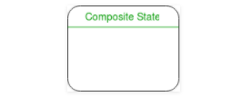
Elements of state chart diagrams
Composite state – We use a rounded rectangle to represent a composite state also. We represent a state with internal activities using a composite state.

Slide 82
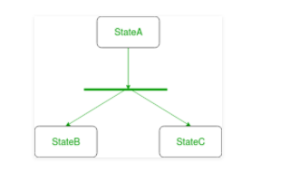
Elements of state chart diagrams
Fork – We use a rounded solid rectangular bar to represent a Fork notation with incoming arrow from the parent state and outgoing arrows towards the newly created states. We use the fork notation to represent a state splitting into two or more concurrent states.

Slide 83
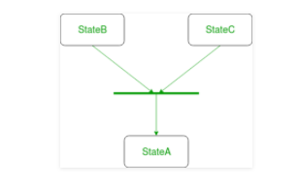
Elements of state chart diagrams
Join – We use a rounded solid rectangular bar to represent a Join notation with incoming arrows from the joining states and outgoing arrow towards the common goal state. We use the join notation when two or more states concurrently converge into one on the occurrence of an event or events.

Slide 84
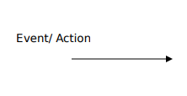
Elements of state chart diagrams
Transition: It is indicated by an arrow. Transition is a relationship between two states which indicates that Event/ Action an object in the first state will enter the second state and performs certain specified actions.

Slide 85

Elements of state chart diagrams
Transition – We use a solid arrow to represent the transition or change of control from one state to another. The arrow is labelled with the event which causes the change in state.

Slide 86
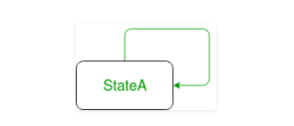
Elements of state chart diagrams
Self transition – We use a solid arrow pointing back to the state itself to represent a self transition. There might be scenarios when the state of the object does not change upon the occurrence of an event. We use self transitions to represent such cases.

Slide 87
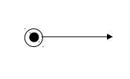
Elements of state chart diagrams
Final State: The end of the state chart diagram is represented by a solid circle surrounded by a circle.

Slide 88
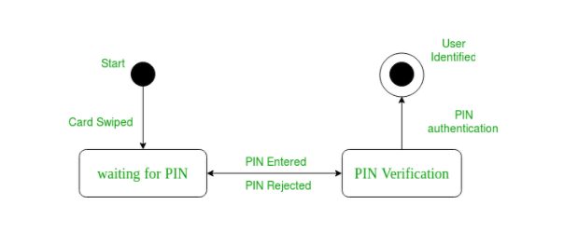
Example state chart for ATM card PIN Verification

Slide 89
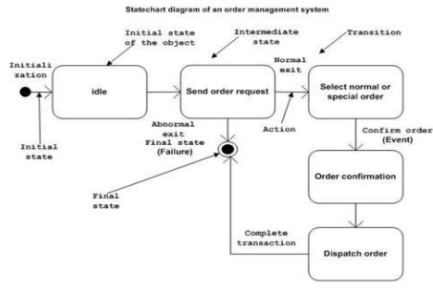
Example state chart for order management system

Slide 90
ACTIVITY Diagram
Object Oriented Design and Programming
18CSC202J

Slide 91
Activity Diagram
Activity diagram is UML behavior diagram which emphasis on the sequence and conditions of the flow
It shows a sequence of actions or flow of control in a system.
It is like to a flowchart or a flow diagram.
It is frequently used in business process modeling. They can also describe the steps in a use case diagram.
The modeled Activities are either sequential or concurrent.

Slide 92
Benefits
It illustrates the logic of an algorithm.
It describes the functions performed in use cases.
Illustrate a business process or workflow between users and the system.
It Simplifies and improves any process by descriptive complex use cases.
Model software architecture elements, such as method, function, and operation.

Slide 93
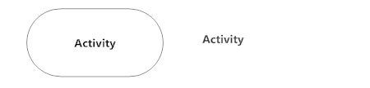
Symbols and Notations
Activity
Is used to illustrate a set of actions.
It shows the non-interruptible action of objects.

Slide 94

Symbols and Notations
Action Flow
It is also called edges and paths
It shows switching from one action state to another. It is represented as an arrowed line.

Slide 95
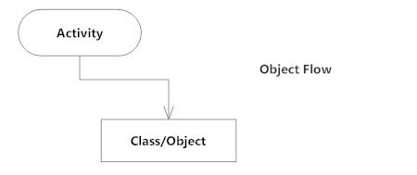
Symbols and Notations
Object Flow
Object flow denotes the making and modification of objects by activities.
An object flow arrow from an action to an object means that the action creates or influences the object.
An object flow arrow from an object to an action indicates that the action state uses the object.

Slide 96

Symbols and Notations
Decisions and Branching
A diamond represents a decision with alternate paths.
When an activity requires a decision prior to moving on to the next activity, add a diamond between the two activities.
The outgoing alternates should be labeled with a condition or guard expression. You can also label one of the paths "else."

Slide 97
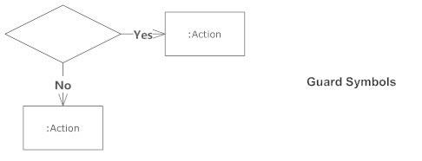
Symbols and Notations
Guards
In UML, guards are a statement written next to a decision diamond that must be true before moving next to the next activity.
These are not essential, but are useful when a specific answer, such as "Yes, three labels are printed," is needed before moving forward.

Slide 98
Symbols and Notations
Synchronization
A fork node is used to split a single incoming flow into multiple concurrent flows. It is represented as a straight, slightly thicker line in an activity diagram.
A join node joins multiple concurrent flows back into a single outgoing flow.
A fork and join mode used together are often referred to as synchronization.

Slide 99
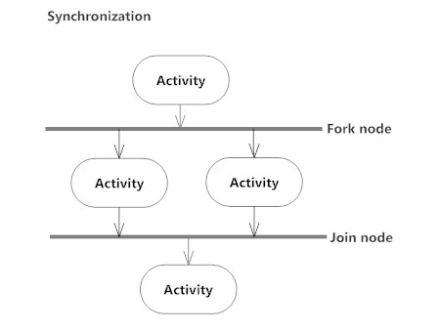
Symbols and Notations
Synchronization

Slide 100
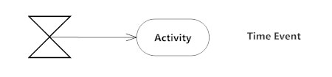
Symbols and Notations
Time Event
This refers to an event that stops the flow for a time; an hourglass depicts it.

Slide 101
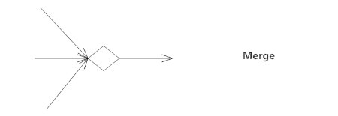

Symbols and Notations
Merge Event
A merge event brings together multiple flows that are not concurrent.
Final State or End Point
An arrow pointing to a filled circle nested inside another circle represents the final action state.

Slide 102
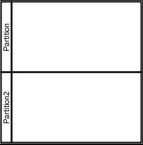
Symbols and Notations
Swimlane and Partition
A way to group activities performed by the same actor on an activity diagram or to group activities in a single thread

Slide 103
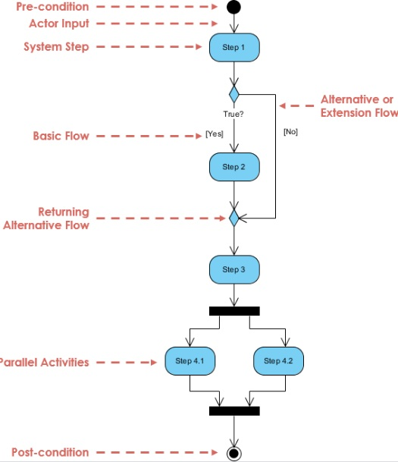
Activity Diagram

Slide 104
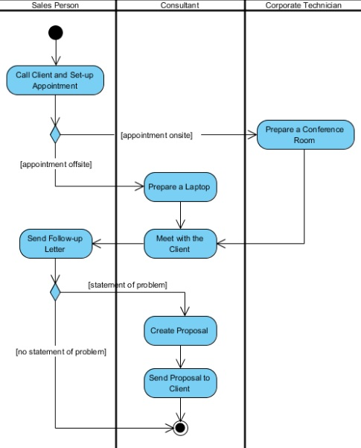
Activity Diagram with Swimlane

Slide 105
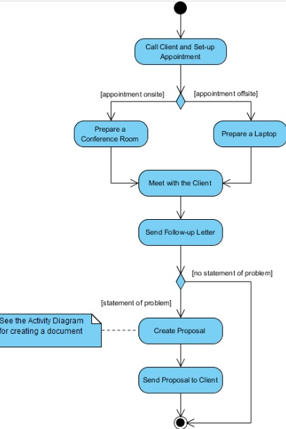
Activity Diagram without Swimlane

